Slide 1

2.3 Scheduling

Slide 2
Scheduling
Introduction to Scheduling
Maximum CPU utilization obtained with multiprogramming
CPU–I/O Burst Cycle – Process execution consists of a cycle of CPU execution and I/O wait
CPU burst distribution

Slide 3
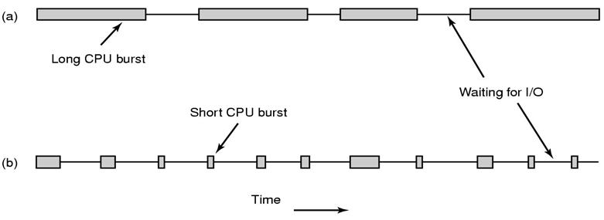
Bursts of CPU usage alternate with periods of I/O wait
– a CPU-bound process
– an I/O bound process

Slide 4
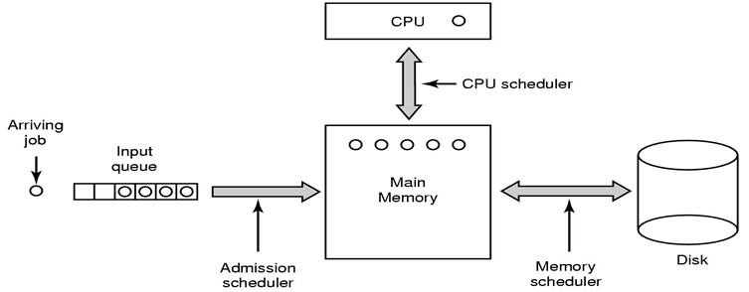
Three level scheduling

Slide 5
Selects from among the processes in memory that are ready to execute, and allocates the CPU to one of them
CPU scheduling decisions may take place when a process:
1. Switches from running to waiting state
2. Switches from running to ready state
3. Switches from waiting or new process is created to ready
4. Terminates
Nonpreemptive scheduling algorithm picks process and let it run until it blocks or until it voluntarily releases the CPU
Preemptive scheduling algorithm picks process and let it run for a maximum of fix time

Slide 6
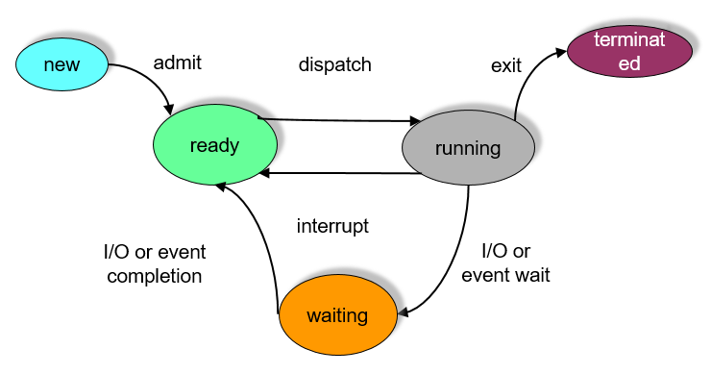

Slide 7
Scheduling Criteria
CPU utilization – keep the CPU as busy as possible
Throughput – # of processes that complete their execution per time unit
Turnaround time – amount of time to execute a particular process
Waiting time – amount of time a process has been waiting in the ready queue
Response time – amount of time it takes from when a request was submitted until the first response is produced, not output (for time-sharing environment)

Slide 8

Optimization Criteria
Max CPU utilization
Max throughput
Min turnaround time
Min waiting time
Min response time

Slide 9
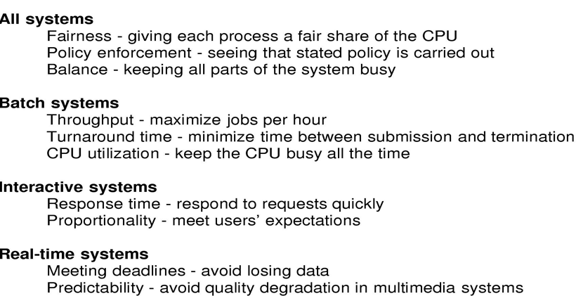
Scheduling Algorithm Goals

Slide 10
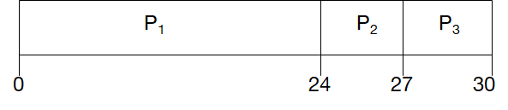
Scheduling
Scheduling in Batch Systems
First-Come, First-Served (FCFS) Scheduling
Process Burst Time
P₁ 24
P₂ 3
P₃ 3
Suppose that the processes arrive in the order: P₁ , P₂ , P₃
The Gantt Chart for the schedule is:
Waiting time for P₁ = 0; P₂ = 24; P₃ = 27
Average waiting time: (0 + 24 + 27)/3 = 17

Slide 11
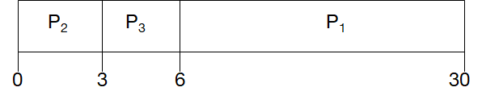
FCFS Scheduling (Cont.)
Suppose that the processes arrive in the order
P₂ , P₃ , P₁
The Gantt chart for the schedule is:
Waiting time for P₁ = 6; P₂ = 0; P₃ = 3
Average waiting time: (6 + 0 + 3)/3 = 3
Much better than previous case
Convoy effect short process behind long process

Slide 12
Shortest-Job-First (SJF) Scheduling
Associate with each process the length of its next CPU burst. Use these lengths to schedule the process with the shortest time
Two schemes:
– nonpreemptive – once CPU given to the process it cannot be preempted until completes its CPU burst
– preemptive – if a new process arrives with CPU burst length less than remaining time of current executing process, preempt. This scheme is know as the
Shortest-Remaining-Time-First (SRTF)
SJF is optimal – gives minimum average waiting time for a given set of processes

Slide 13
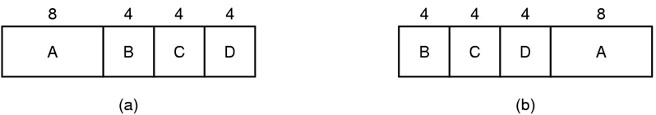

An example of shortest job first scheduling

Slide 14
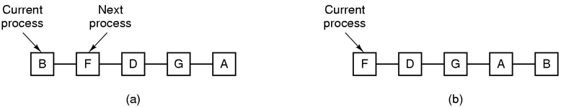
Scheduling
Scheduling in Interactive Systems
Round Robin Scheduling
– list of runnable processes (a)
– list of runnable processes after B uses up its quantum (b)

Slide 15
Round Robin (RR)`
Each process gets a small unit of CPU time (time quantum), usually 10-100 milliseconds. After this time has elapsed, the process is preempted and added to the end of the ready queue.
If there are n processes in the ready queue and the time quantum is q, then each process gets 1/n of the CPU time in chunks of at most q time units at once. No process waits more than (n-1)q time units.
Performance
– q large ⇒ FIFO
– q small ⇒ q must be large with respect to context switch, otherwise overhead is too high

Slide 16
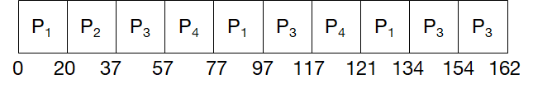
Example of RR with Time Quantum = 20
Process Burst Time
P₁ 53
P₂ 17
P₃ 68
P₄ 24
The Gantt chart is:
Typically, higher average turnaround than SJF, but better response

Slide 17
Priority Scheduling: A priority number (integer) is associated with each process
– The CPU is allocated to the process with the highest priority
– Preemptive
– Nonpreemptive
SJF is a priority scheduling where priority is the predicted next CPU burst time
Problem ≡ Starvation – low priority processes may never execute
Solution ≡ Aging – as time progresses increase the priority of the process

Slide 18
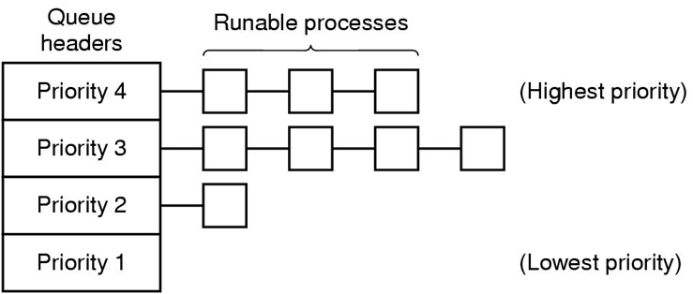
A scheduling algorithm with four priority classes

Slide 19
Scheduling
Scheduling in Real-Time Systems
Hard real-time systems – required to complete a critical task within a guaranteed amount of time
Soft real-time computing – requires that critical processes receive priority over less fortunate ones

Slide 20
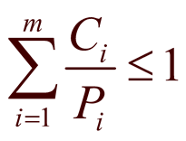
Schedulable real-time system
Given
– m periodic events
– event i occurs within period P_{i} and requires C_{i} seconds
Then the load can only be handled if

Slide 21
Scheduling
Policy versus Mechanism
Separate what is allowed to be done with how it is done
– a process knows which of its children threads are important and need priority
Scheduling algorithm parameterized
– mechanism in the kernel
Parameters filled in by user processes
– policy set by user process

Slide 22
Scheduling
Thread Scheduling
Local Scheduling – How the threads library decides which thread to put onto an available
Global Scheduling – How the kernel decides which kernel thread to run next

Slide 23
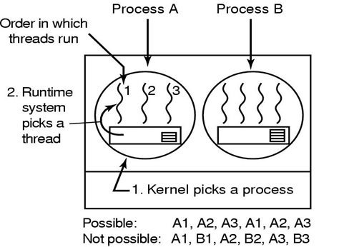
Possible scheduling of user-level threads
50-msec process quantum
Threads run 5 msec/CPU burst

Slide 24
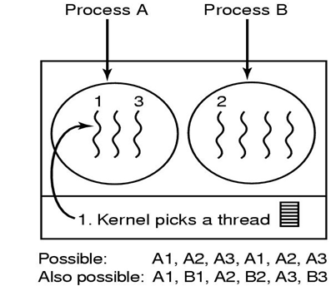
Possible scheduling of kernel-level threads
50-msec process quantum
Threads run 5 msec/CPU burst

